Slide 1
Chapter 1: What is the Internet of Things?
Introduction to the Internet of Things
Notes:
Cisco Networking Academy Program
Introduction to the Internet of Things
Chapter 1: What is the Internet of Things?

Slide 2
Chapter 1 - Sections & Objectives
1.1 Internet of Things
Explain the positive effects of the Internet of Everything on our everyday lives
1.2 The Value of the IoE
Identify the elements of the IoE
1.3 Globally Connected
Explain how multiple networks are used in everyday life.
Notes:
2

Slide 3
Internet of Things The Internet
The Internet
A network of networks
Using a physical cable or wireless media for connection
Transitioning to the IoT
Notes:
1.1 – Internet of Things
1.1.1 – The Internet

Slide 4
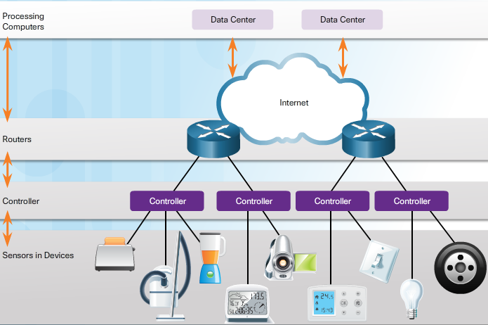
Things as an Element Connecting to Non-Traditional Computer Things (Cont.)
Notes:
2.1 – Things as an Element
2.1.3 – Connecting to Non-Traditional Computer Things (Cont.)

